Slide 1
“Hello world” of deep learning

Slide 2



Keras
If you want to learn theano:
http://speech.ee.ntu.edu.tw/~tlkagk/courses/MLDS_2015_2/Lecture/Theano%20DNN.ecm.mp4/index.html
http://speech.ee.ntu.edu.tw/~tlkagk/courses/MLDS_2015_2/Lecture/RNN%20training%20(v6).ecm.mp4/index.html
Very flexible
or
Need some effort to learn
Easy to learn and use
Interface of TensorFlow or Theano
(still have some flexibility)
You can modify it if you can write TensorFlow or Theano
keras
Notes:
適合初學者
台大上課
太過 ＯＰ
Toolkit

Slide 3
Keras
François Chollet is the author of Keras.
He currently works for Google as a deep learning engineer and researcher.
Keras means horn in Greek
Documentation: http://keras.io/
Example: https://github.com/fchollet/keras/tree/master/examples
Notes:
角；觸角，觸鬚牛角
而謹慎的佩涅洛佩則説道：“尊敬的客人，夢幻是很難解釋清楚的，并不是所有的夢景都會變爲現實。來去無蹤的夢神一般穿行於兩座大門，一座由牛角制成，一座由象牙雕成。穿過象牙大門來到人的夢鄉的夢神，只會欺人，所現所説不會成爲現實。而通過牛角大門進入的夢神，卻給任何一個凡人帶真實可信的訊息。但是，我的夢境不是後一位夢神提供的，雖然那里情節讓我心情舒暢。

Slide 4
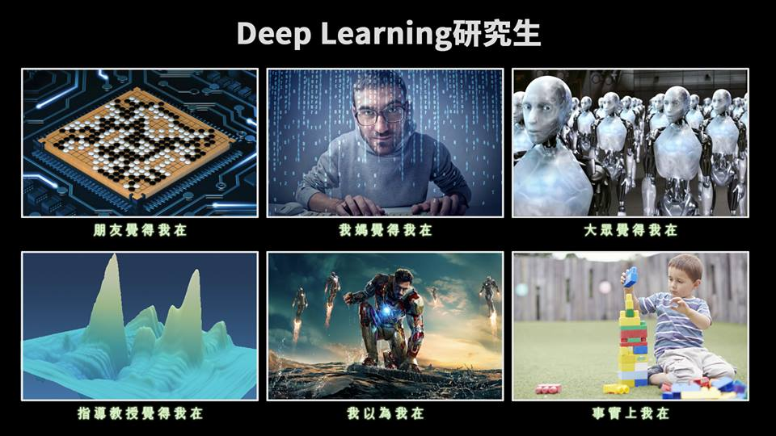
使用 Keras 心得
感謝 沈昇勳 同學提供圖檔

Slide 5
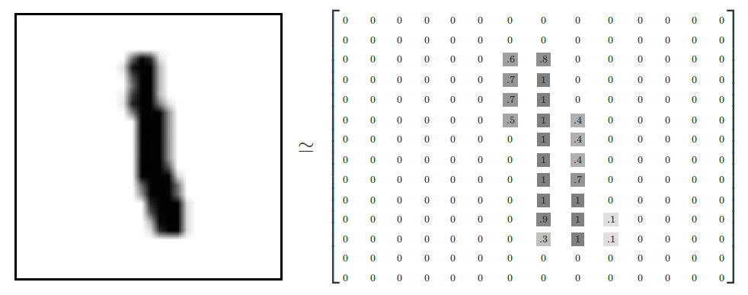
Example Application
Handwriting Digit Recognition
Machine
“1”
28 x 28
MNIST Data: http://yann.lecun.com/exdb/mnist/
“Hello world” for deep learning
Keras provides data sets loading function: http://keras.io/datasets/

Slide 6
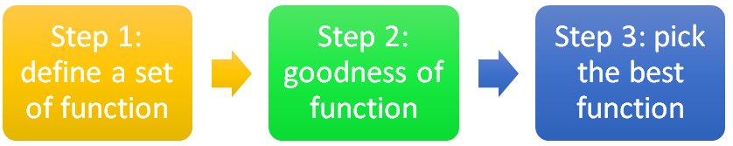



Keras
28x28
……
500
……
softplus, softsign, relu, tanh, hard_sigmoid, linear
500
……
Softmax
y₁
y₂
y₁₀
……
Notes:
https://en.wikipedia.org/wiki/Activation_function
Theno: Universite de Montr ´ eal
Yoshua Bengio

Slide 7
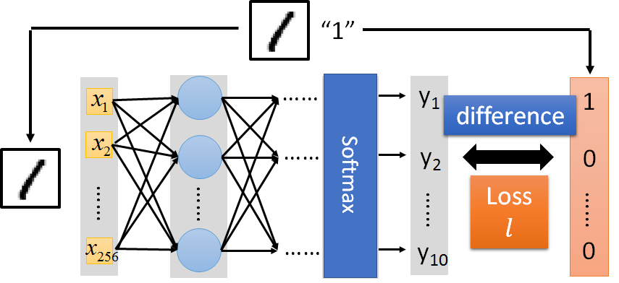

Keras
Several alternatives: https://keras.io/objectives/
Notes:
Theno: Universite de Montr ´ eal
Yoshua Bengio

Slide 8
Keras
Step 3.1: Configuration
SGD, RMSprop, Adagrad, Adadelta, Adam, Adamax, Nadam
Step 3.2: Find the optimal network parameters
Training data
(Images)
Labels
(digits)
In the following slides
Notes:
Theno: Universite de Montr ´ eal
Yoshua Bengio

Slide 9
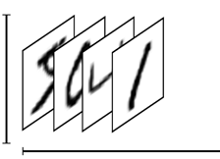
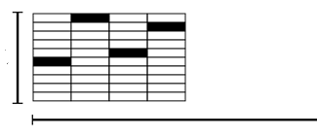
Keras
Step 3.2: Find the optimal network parameters
numpy array
numpy array
28 x 28
=784
……
10
……
Number of training examples
Number of training examples
https://www.tensorflow.org/versions/r0.8/tutorials/mnist/beginners/index.html
Notes:
Theno: Universite de Montr ´ eal
Yoshua Bengio

Slide 10
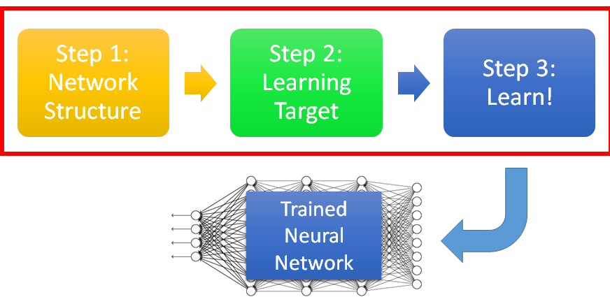


Keras
Save and load models
http://keras.io/getting-started/faq/#how-can-i-save-a-keras-model
How to use the neural network (testing):
case 1:
case 2:
Notes:
Scalar test loss (if the model has a single output and no metrics) or list of scalars (if the model has multiple outputs and/or metrics). The attributemodel.metrics_names will give you the display labels for the scalar outputs.

Slide 11
Keras
Using GPU to speed training
Way 1
THEANO_FLAGS=device=gpu0 python YourCode.py
Way 2 (in your code)
import os
os.environ["THEANO_FLAGS"] = "device=gpu0"
Notes:
THEANO_FLAGS=device=gpu0 python YourCode.py
import os
os.environ["THEANO_FLAGS"] = "device=cpu"

Slide 12
Live Demo

Slide 13














Mini-batch
We do not really minimize total loss!
Randomly initialize network parameters
x¹
NN
y¹
Pick the 1st batch
$${\hat{y}}^{1}$$
$$C^{1}$$
$$L′=C^{1}+C^{31}+⋯$$
Mini-batch
NN
x³¹
y³¹
$${\hat{y}}^{31}$$
Update parameters once
$$C^{31}$$
Pick the 2nd batch
……
$$L′′=C^{2}+C^{16}+⋯$$
Update parameters once
x²
NN
y²
$${\hat{y}}^{2}$$
$$C^{2}$$
…
Until all mini-batches have been picked
Mini-batch
x¹⁶
NN
y¹⁶
$${\hat{y}}^{16}$$
$$C^{16}$$
one epoch
……
Repeat the above process
Notes:
Each time we update paramters, we have different target -> 不安
Shuffle data, and repeat above process

Slide 14






Mini-batch
Batch size influences both speed and performance. You have to tune it.
Pick the 1st batch
x¹
NN
y¹
$${\hat{y}}^{1}$$
$$L′=C^{1}+C^{31}+⋯$$
$$l^{1}$$
Mini-batch
NN
Update parameters once
x³¹
y³¹
$${\hat{y}}^{31}$$
$$l^{31}$$
Pick the 2nd batch
……
$$L′′=C^{2}+C^{16}+⋯$$
100 examples in a mini-batch
Update parameters once
Batch size = 1
…
Until all mini-batches have been picked
Stochastic gradient descent
Repeat 20 times
one epoch
Notes:
Let’s try it.

Slide 15

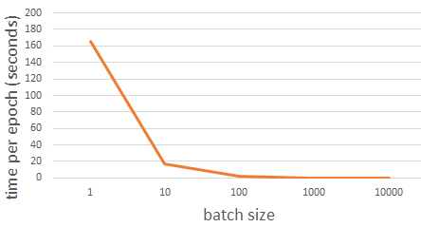
Speed
Smaller batch size means more updates in one epoch
E.g. 50000 examples
batch size = 1, 50000 updates in one epoch
batch size = 10, 5000 updates in one epoch
166s
1 epoch
17s
10 epoch
166s
Batch size = 1 or 10, update the same amount of times in the same period.
Batch size = 10 is more stable
GTX 980 on MNIST with 50000 training examples
17s

Slide 16


Speed - Matrix Operation
……
y₁
W¹
W²
W^{L}
……
y₂
b¹
b²
b^{L}
……
……
……
……
……
x
a¹
a²
y
……
y_{M}
y
x
$$=f\left( \right)$$
Forward pass
(Backward pass is similar)
W^{L}
…
W²
W¹
x
b¹
b²
…
b^{L}
+
+
+
$$σ\left( \right)$$
$$=σ\left( \right)$$
$$σ\left( \right)$$
Notes:
Draw it?

Slide 17











Speed - Matrix Operation
Why mini-batch is faster than stochastic gradient descent?
Stochastic Gradient Descent
$$z^{1}$$
=
$$W^{1}$$
$$x$$
$$z^{1}$$
=
$$W^{1}$$
$$x$$
……
Mini-batch
matrix
Practically, which one is faster?
$$z^{1}$$
$$z^{1}$$
=
$$W^{1}$$
$$x$$
$$x$$

Slide 18
Performance
Larger batch size yields more efficient computation.
However, it can yield worse performance

Slide 19
















Shuffle the training examples for each epoch
Epoch 1
Epoch 2
x¹
NN
y¹
x¹
NN
y¹
$${\hat{y}}^{1}$$
$${\hat{y}}^{1}$$
$$l^{1}$$
$$l^{1}$$
Mini-batch
NN
Mini-batch
NN
x³¹
y³¹
$${\hat{y}}^{31}$$
x³¹
y³¹
$${\hat{y}}^{31}$$
$$l^{31}$$
$$l^{17}$$
……
……
Don’t worry. This is the default of Keras.
x²
NN
y²
x²
NN
y²
$${\hat{y}}^{2}$$
$${\hat{y}}^{2}$$
$$l^{2}$$
$$l^{2}$$
Mini-batch
NN
Mini-batch
NN
x¹⁶
y¹⁶
$${\hat{y}}^{16}$$
x¹⁶
y¹⁶
$${\hat{y}}^{16}$$
$$l^{16}$$
$$l^{26}$$
……
……

Slide 20
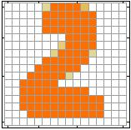



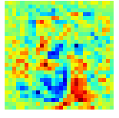
Analysis
When did the neuron has the largest output?
……
……
Red: positive
Arranging the weights according to the pixels they connected
Blue: negative
The neurons in the first layer usually detect part of the digits.

Slide 21
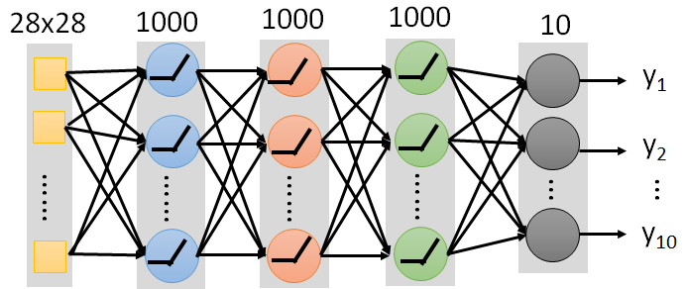
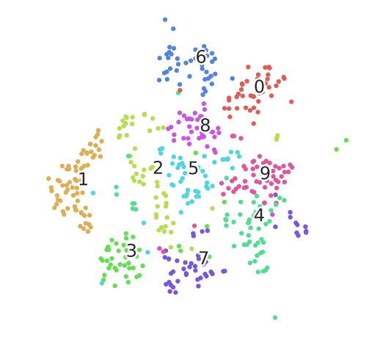

Slide 22
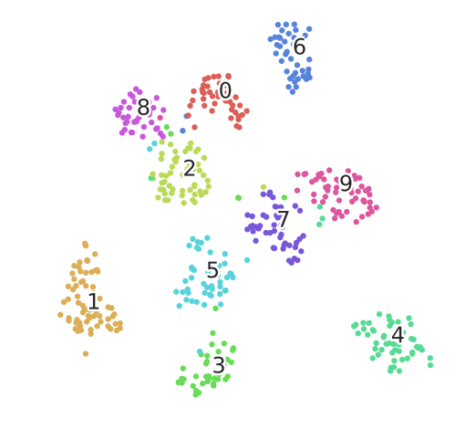

Slide 23
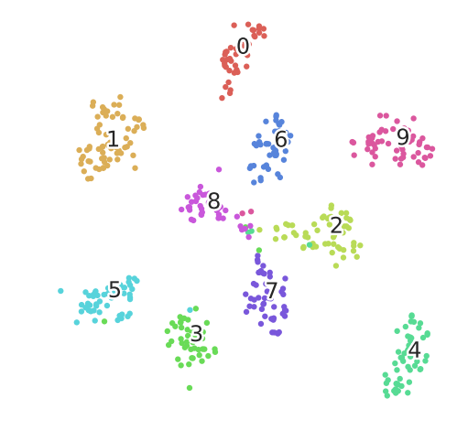

Slide 24




Try another task
政治
“stock” in document
Machine
經濟
體育
“president” in document
體育
政治
財經
http://top-breaking-news.com/

Slide 25
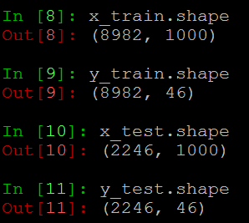
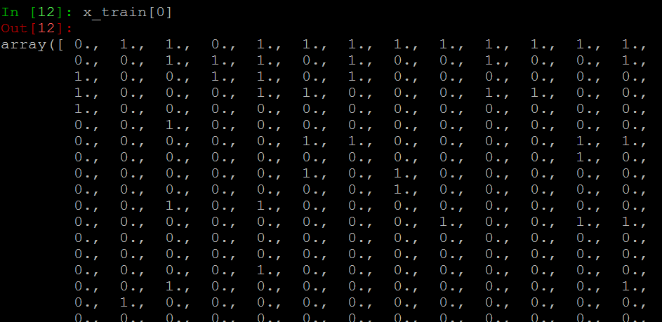
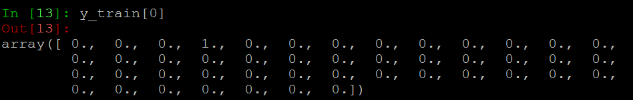
Try another task

Slide 26
Live Demo

